Slide 1
Java File Class & Text I/O

Slide 2
The File Class
The File class is intended to provide an abstraction that deals with most of the machine-dependent complexities of files and path names in a machine-independent fashion.
The filename is a string.
The File class is a wrapper class for the file name and its directory path.

Slide 3
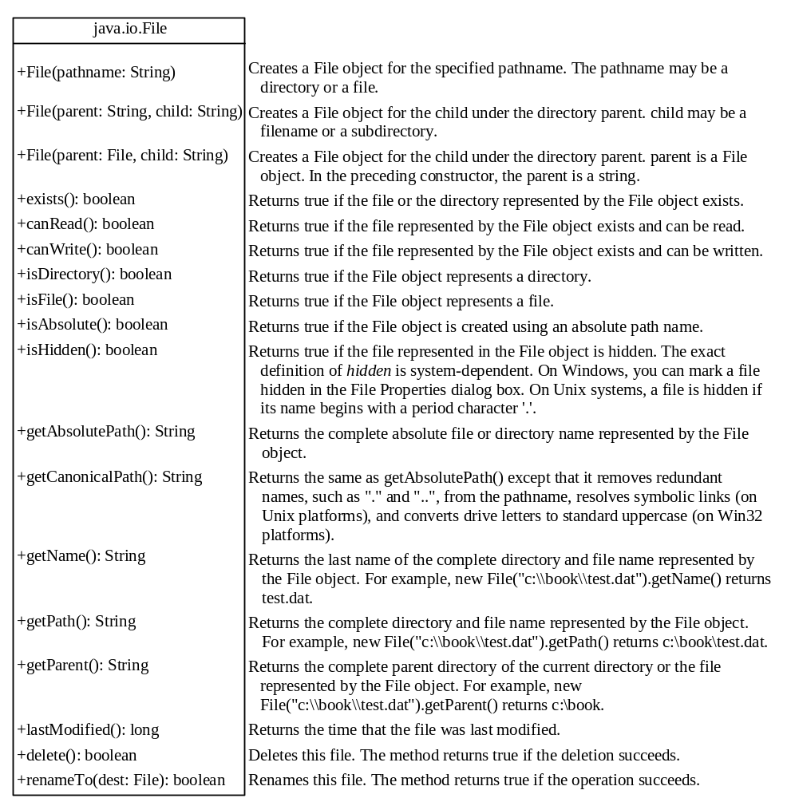
Obtaining file properties and manipulating file

Slide 4
Text I/O
A File object encapsulates the properties of a file or a path, but does not contain the methods for reading/writing data from/to a file.
In order to perform I/O, you need to create objects using appropriate Java I/O classes.
The objects contain the methods for reading/writing data from/to a file.
Scanner and PrintWriter classes can be used to read/write strings and numeric values from/to a text file.

Slide 5
Example: File Properties
Create files in a platform-independent way
Use the methods in the File class to obtain their properties (isFile, isDirectory, isHidden, exists, canWrite, etc.)

Slide 6

Writing Data Using PrintWriter

Slide 7
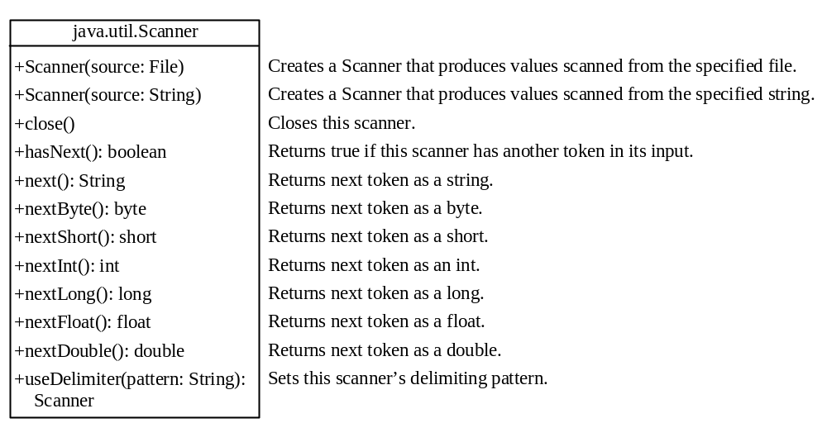
Reading Data Using Scanner

Slide 8
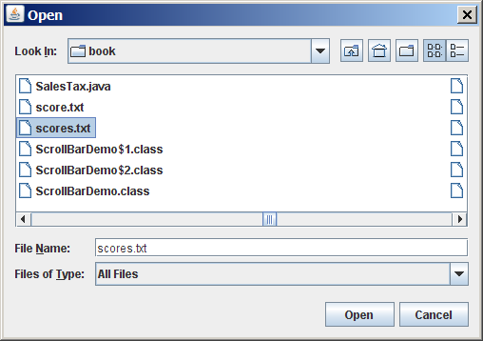
(GUI) File Dialogs
JFileChooser fileChooser = new JFileChooser();
if (fileChooser.showOpenDialog(null) == JFileChooser.APPROVE_OPTION)
{
// Get the selected file
java.io.File file = fileChooser.getSelectedFile();
}

